Slide 1

The short-term economic impact of the Covid-19 pandemic in the EU
Kolozsi, Pál Péter
2020. 12. 10.
Zagreb, Croatia
University of Public Service, Ludovika
Economy and Competitiveness Research Institute

Slide 2
This time is really different…
Great depression
(1929-1933)
Great lockdown
(2020-?)
Great recession
(2007-2008)

Slide 3
The nature of the shock
Economic developments in 2020 have been fundamentally determined by the pandemic caused by the Covid-19, the public health and economic policy measures taken in response.
Supply or demand shock?
The distinction is important because the crisis management of negative demand and supply shocks requires very different forms on the fiscal and monetary sides.
In the case of the coronavirus: Both!
The shock is exogenous: Households would be very happy to consume and companies would be ready to invest, but restrictions by the state and/or caution (fear) impose a physical barrier to accessing services and products
Capacities (sources of income) must be kept alive so that demand can show up again after restrictions have been lifted + the state also has to contribute to the restructuring of the economy in order to avoid a repeated interruption in demand
What is the correlation between the macroeconomic and vulnerability, characteristics of countries and the extent of the shock caused by COVID-19?

Slide 4
Methodology
Countries were divided into 7 groups, based on fiscal, social, and external vulnerability indicators. Clusters represent the situation when Covid-19 and the resulting economic impacts reached a given country.
Specific patterns of country groups are explored in the evolution of crisis period indicators of production, labor market, mobility and risk premium.
The aim of the analysis is to find a correlation between pre-crisis preparedness and the extent of the economic shock caused by the crisis.
Cluster indicators
change of the budget balace (2016–2019);
change in gross government debt (2016-2019);
change of the export ratio (2016-2019);
contribution of tourism to GDP (av. 2016-2018);
Share of social expenditures (av, 2016-2018);
• GINI ind. (av. 2016-2018)
Notes:
The study examines the preparedness, vulnerability, exposure and performance of 25 European countries during the economic crisis caused by the Covid-19 epidemic.

Slide 5
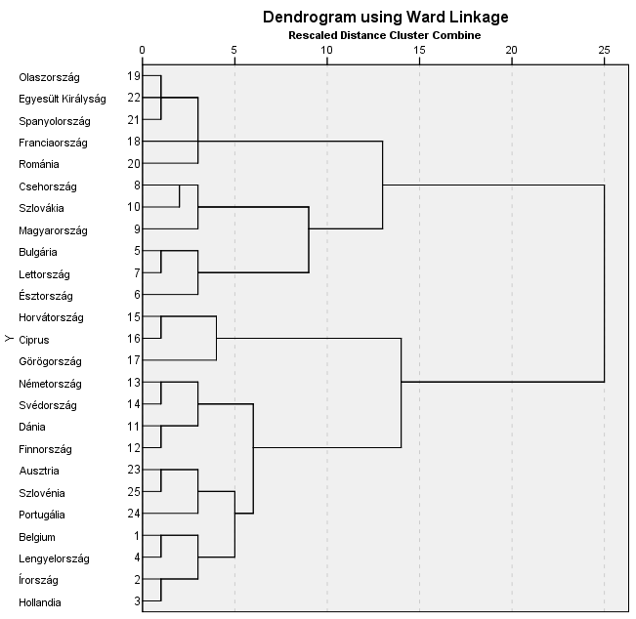
The seven clusters

Slide 6
Clusters are clearly separable in the social indicators. As for the other four indicators describing the initial situation before the crisis, the separation of the seven clusters is not so marked.
Clusters were analysed for the period March-June 2020, based on four indicators
(1) change in industrial production
(2) change in worker mobility,
(3) change in unemployment, and
(4) change in the interest rate spreads of government bonds.

Slide 7
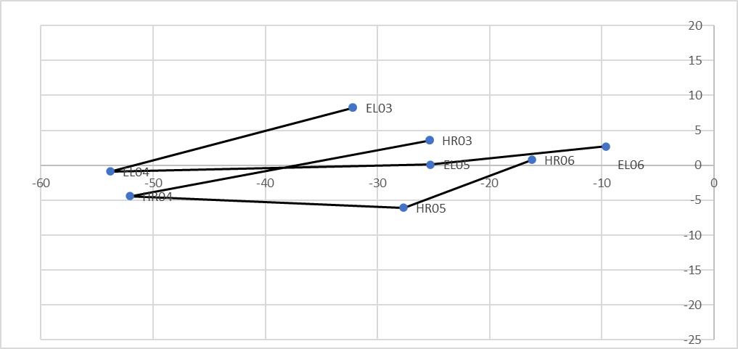

Slide 8
Conclusions (1)
The combination of annual indicators and variables describing their behaviours during the crisis does not make it possible to lay down general rules.
All clusters showed a decline in industrial production compared to the short-term pre-crisis reference period. The heterogeneity within the clusters increased.
The average of each cluster increased slightly in terms of unemployment, while heterogeneity within the cluster did not increase.
In the case of workforce mobility, cluster essentially moved in parallel, starting from roughly the same level and reaching app. the same level in the direction of declining mobility.
Larger deviations during the shift towards increasing yields can be detected in connection with the risk spread on five-year government bonds.

Slide 9
Conclusions (2)
Our analysis gave rise to the conclusion that the four crisis indicators suggested a trend of homogeneity between clusters.
Decline in mobility has mostly been accompanied by a slowdown in industrial production, not unemployment, which may reflect the impact of economic policy measures aimed at maintaining jobs.
The short-term decline caused by the first wave of the coronavirus was not fundamentally rooted in different exposures in terms of public finances, social aspects and external economy.
This is consistent with the initial theoretical basis of our analysis, stating that a crisis caused by an exogenous shock does not exert the same effect as a shock based on economic reasons.
FURTHER RESEARCH IS NEEDED!

Slide 10
Thank You very much for your attention!

